Slide 1

AI Startup Success Predictor
A Comprehensive Data-Driven Investment Tool for Venture Capital

Slide 2
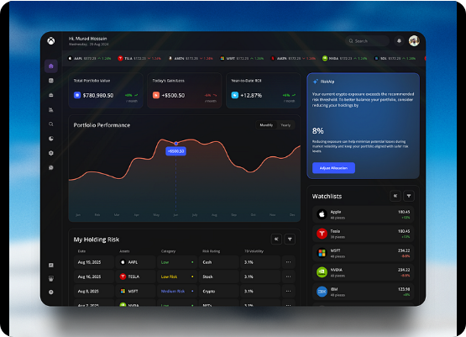
The Challenge
•
High Failure Rates: A massive percentage of startups fail within their first five years, leading to substantial VC losses.
•
Subjective Decisions: Traditional investments rely heavily on intuition, "gut feelings", and limited qualitative data.
•
The Need: The market lacks an automated, objective, and data-driven approach to evaluate long-term viability based on historical metrics.

Slide 3
Phase 1 & 2: Data Engineering
Led by Ziad: Extracting insights, handling missing data, treating outliers, and building robust features from raw historical startup data.

Slide 4
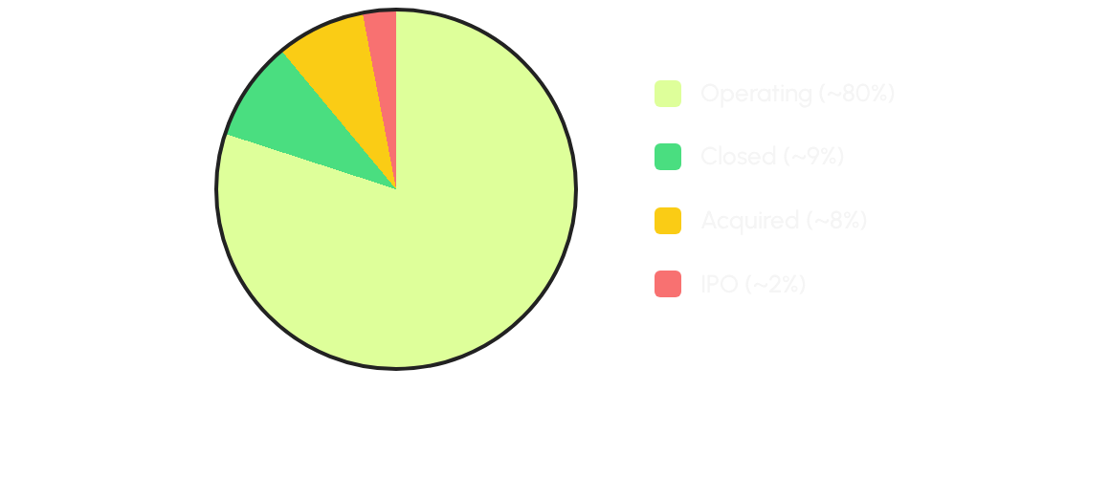
Target Variable Imbalance
*The vast majority of startups are "Operating", making the target variable highly imbalanced. Accuracy alone is an insufficient metric.

Slide 5
Funding Insights
2%
Significant Funding Disparity
Exploratory Data Analysis (EDA) revealed extreme outliers in funding amounts, highly characteristic of the startup ecosystem.
Although only ~2% of companies reached an IPO, their median funding dwarfed that of 'Closed' or 'Operating' companies, proving funding is a vital predictive feature.
Reach IPO

Slide 6
Data Cleaning & Preprocessing
Missing Values (Numerical): Filled utilizing the median value to avoid skewness caused by extreme financial outliers.
Missing Values (Categorical): Handled by imputing the statistical mode or creating 'Unknown' categories for robust mapping.
Outlier Capping (Winsorization): Clipped data at the 1st and 95th percentiles. Extreme funding events are legitimate, so capping prevents model distortion without dropping rows.
Invalid Entries: Removed mathematically impossible inputs (e.g., negative company ages or future dates like year 2115).

Slide 7


Feature Engineering
•
Company Age: Derived from founding date up to the reference maximum year (2015). A crucial maturity indicator.
•
Funding Duration: Time span between the first and last funding rounds. Indicates sustained investor confidence.
•
Time to First Funding: How fast a startup proved market fit to secure initial capital.
•
Primary Category: Extracted the dominant sector from complex multi-category lists to simplify encoding.

Slide 8
Phase 3: Machine Learning
Led by Mohamed: Transforming features, testing diverse algorithms, hyperparameter tuning, and leveraging Explainable AI (SHAP) for model interpretability.

Slide 9


Data Transformation
Categorical Encoding
Feature Scaling
The target variable ('status') was label encoded into numeric values (0 to 3). High-cardinality features like Country and Category were grouped (Top 10 / Top 20) and One-Hot Encoded to limit dimensionality.
Applied StandardScaler exclusively fitted on the training set to ensure mean=0 and variance=1. This prevents data leakage and ensures distance-based metrics perform optimally.

Slide 10
Model Evaluation
Algorithm | Accuracy | Precision | Recall | F1-Score
Gradient Boosting (Tuned) | 92.5% | 91.8% | 92.5% | 91.5%
Random Forest | 91.2% | 90.1% | 91.2% | 90.2%
AdaBoost | 89.4% | 88.5% | 89.4% | 88.6%
Logistic Regression | 85.1% | 83.2% | 85.1% | 83.5%
*F1-Score is prioritized due to the imbalanced nature of the dataset. Grid Search CV was used for optimal tuning.

Slide 11
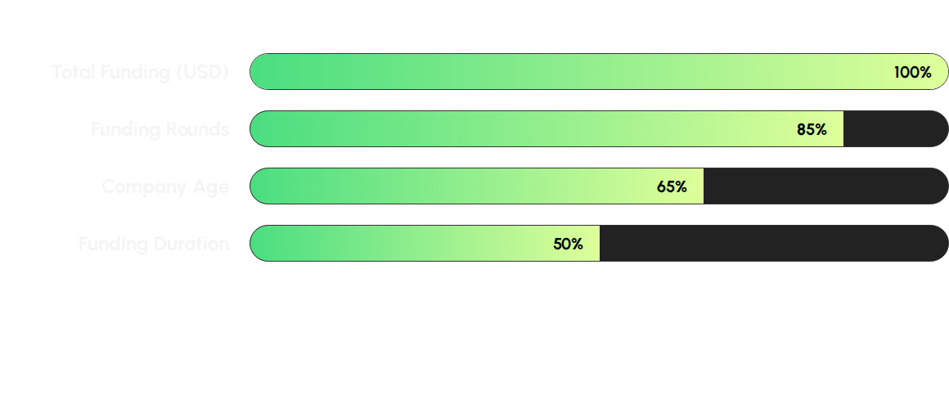
Feature Importance
*Sustained funding across multiple rounds carries extreme weight for prediction, significantly outweighing early-stage parameters like country or primary category.

Slide 12
Phase 4: Deployment
Led by Ahmed: Translating the robust machine learning pipeline into an accessible, real-time web application using Streamlit for VC stakeholders.

Slide 13
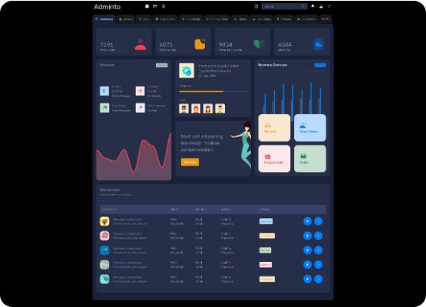
Interactive Dashboard
•
User-Centric Design: Developed a smooth Streamlit interface catering to non-technical analysts.
•
Pre-loaded Configs: Scalers, Label Encoders, and median boundaries saved as `.pkl` and `.json` artifacts for consistency in production.
•
Report Generation: Instantly export analysis results into downloadable CSV reports directly from the UI.

Slide 14
Key Features
Bulk Processing
What-If Simulator
VC analysts can upload entire CSV files to evaluate hundreds of startups concurrently. The system processes the pipeline and outputs bulk predictions and confidence scores.
Real-time sliders allow users to manipulate inputs like "Funding Rounds" or "Company Age" to visualize instantly how scenario adjustments impact success probability.

Slide 15






Meet the Team
Ziad Bahaa
Mohamed Ahmed
Ahmed Wagdy
Data & Engineering
Machine Learning
Deployment
Led Exploratory Data Analysis, cleaning, handling outliers, and engineering key timeline features.
Trained and optimized multiple models, achieving a 91.5% F1-Score using Gradient Boosting.
Developed the complete Streamlit web application with bulk prediction and what-if simulation features.

Slide 16
Questions & Answers
Ready to revolutionize your investment strategy?
Machine Learning for Data Science Team | Cretiva NTI

